Slide 1

Problem statement 15: Invent own challenge
FLARE
Fallback Logic for Active Radiation Events
Team 3:
I.Mounika - 23WH1A0492
K.Sphoorti - 23WH1A0494
K.Vyshamya - 23WH1A0468

Slide 2


PROBLEM STATEMENT
Solar flares pose a serious risk to satellites and CubeSats, but current systems rely on delayed ground-based alerts.
There is a need for an onboard, low-power, real-time detection system that can react instantly to solar radiation spikes.

Slide 3
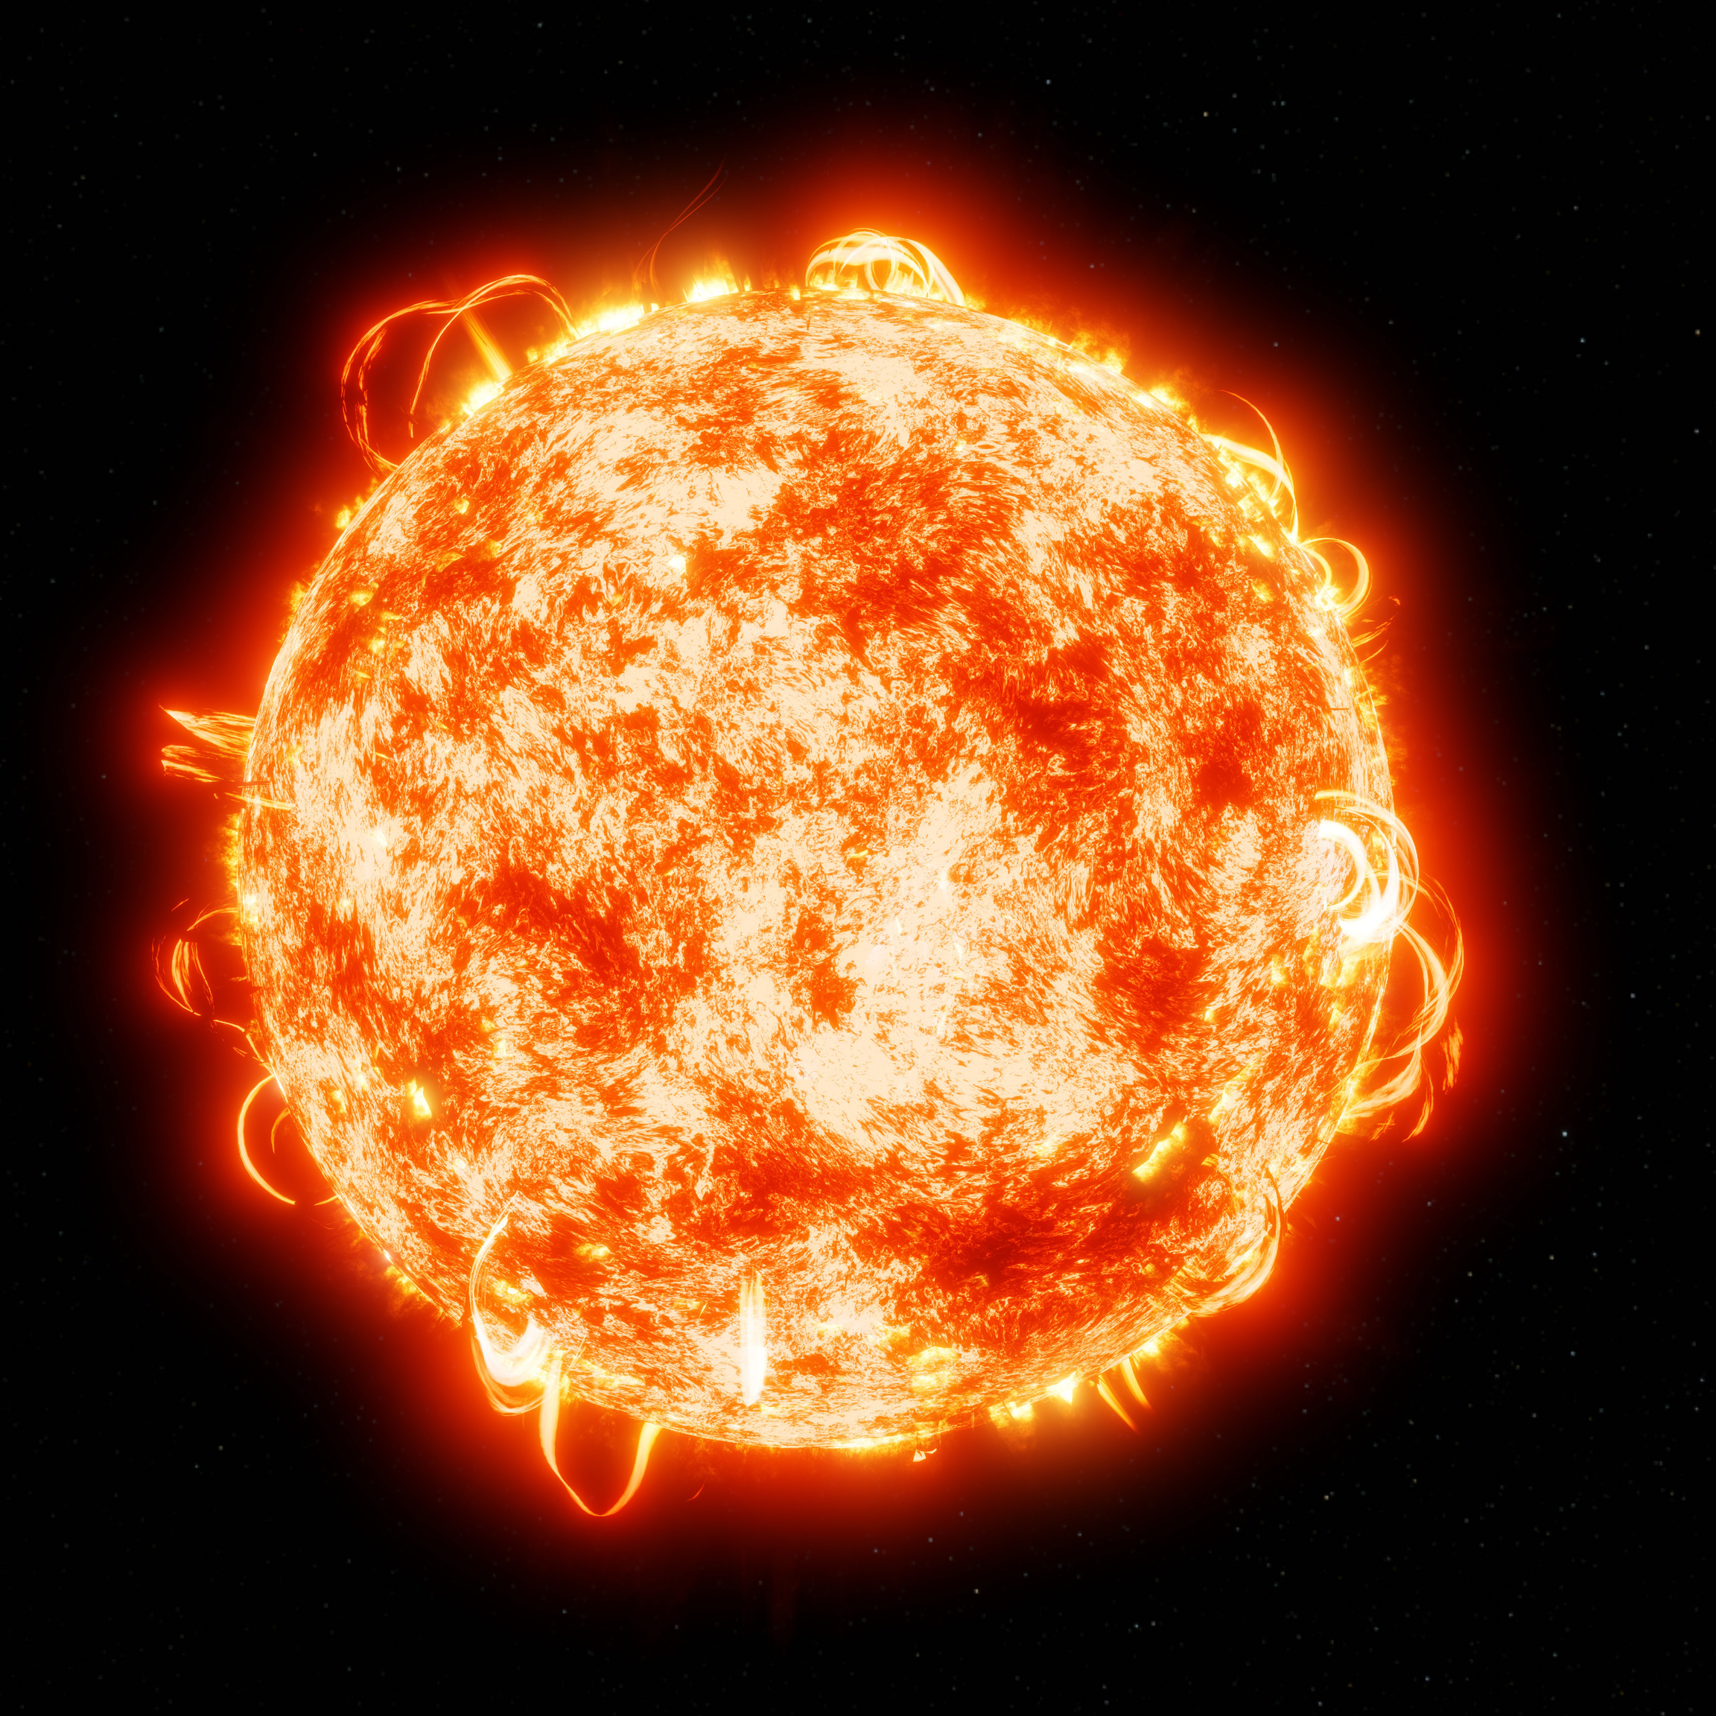
SOLAR FLARES
Solar flares are intense bursts of electromagnetic radiation from the Sun, caused by the release of magnetic energy. This release emits X-rays, ultraviolet light, and streams of high-energy particles.
Effects on Earth and Space:
Satellites
Astronauts
Earth

Slide 4
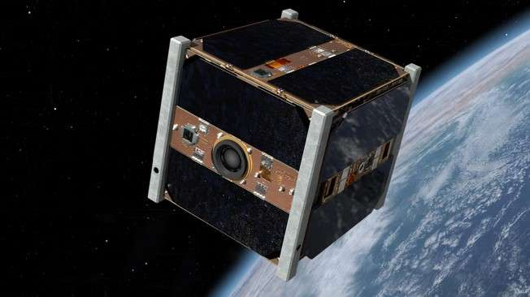
CUBE SATELLITE
CubeSatellites are miniaturized, low-cost satellites built in multiples of 10×10×10 cm units, widely used for space research and applications.
How CubeSats are affected by Solar Flares:
Radiation Damage to Electronics
Communication Disruptions
Power Generation Issues
Increased Atmospheric Drag

Slide 5
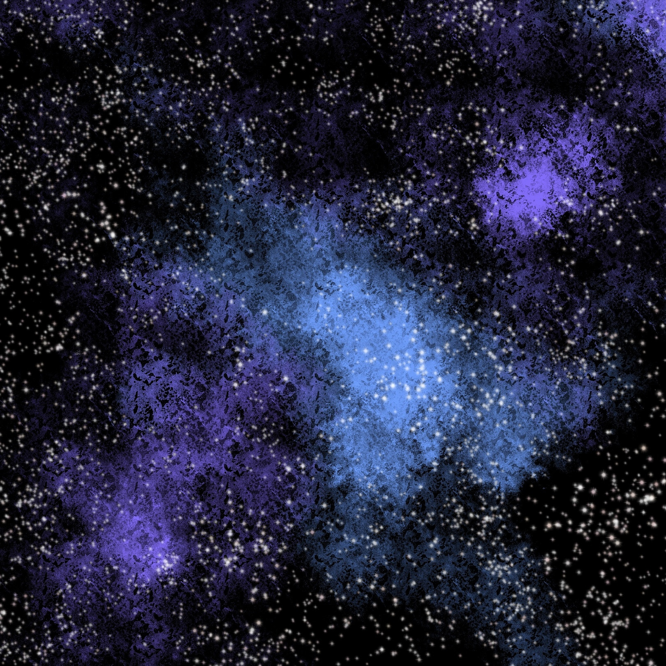
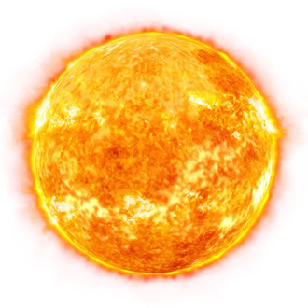
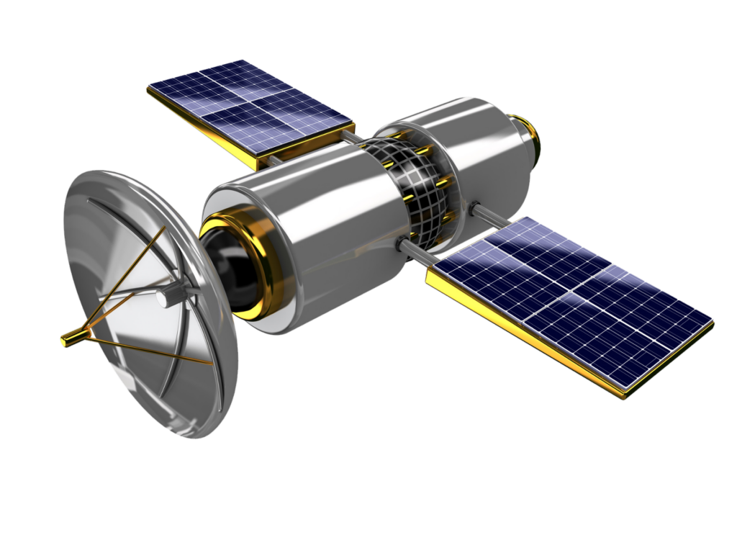
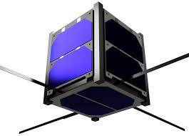

EXISTING SOLUTION MECHANISM
Aditya L1
Location: L1 point, ~1.5M km from Earth for continuous Sun monitoring.
Detection: Spots solar flares 5–15 min before particles reach Earth.
Data Flow: Sun → Aditya L1 → Ground Station → CubeSats.
Limitation: Alerts delayed; CubeSats stay passive.
Surya AI
Model: AI forecasts flare probability using solar data.
Prediction: Hours ahead, ~70–80% accurate.
Power: Needs ground-based supercomputers.
Limitation: Dependent on ground link; CubeSats not autonomous.
Solar flares
Solar Monitoring Satellite
Cube Satellite
Ground station

Slide 6
PROPOSED SOLUTION MECHANISM
Onboard Flare Detection: Equip CubeSats with sensors and logic to detect solar flares directly in space, removing reliance on delayed ground alerts.
FPGA Prototype: Start with an FPGA-based implementation for flexibility in testing algorithms, later migrating to SoC/ASIC for efficiency and lower power.
Real-Time Response: Enable a built-in fallback mechanism so the CubeSat can autonomously switch to safe mode or reconfigure systems when a flare is detected.
Autonomous Protection: This approach makes CubeSats self-reliant, ensuring rapid protection against solar events without waiting for external communication.
Solar flares
Cube Satellite
(with solar flare detecting system)
Ground station

Slide 7



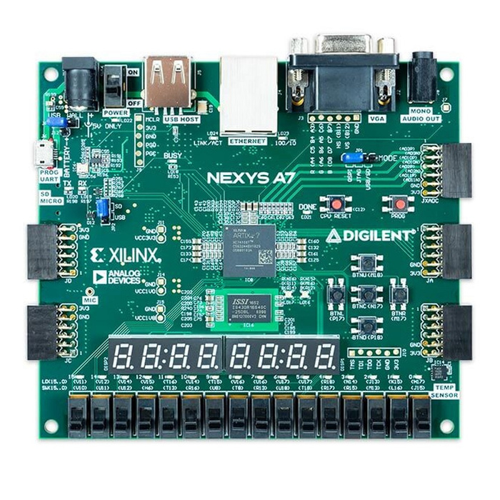
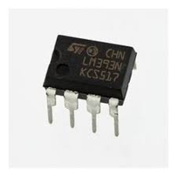

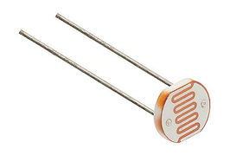


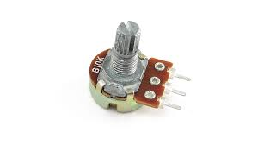
TECHNOLOGY USED FOR PROTOTYPE
Start
Enable ADC
LM393 (Comparator)
Measure LDR signal (V_LDR)
Read Threshold (V_TH) from potentiometer
LDR sensor (light detection)
V_TH > V_LDR
Nexys Diligent A7 FPGA
Display ‘NORMAL’ on
FPGA
7-segment display
Display ‘FALLBACK’ on FPGA
7-segment display
Potentiometer(Reference voltage)
Read Inputs
Vivado Xilinx (Verilog)

Slide 8
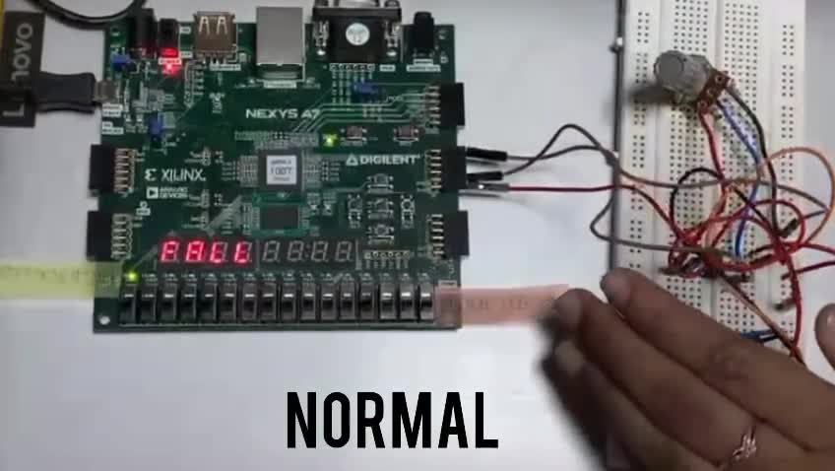

Slide 9
IN 24 HRS,
> took datasets from NASA as reference for solar radiations instead of torch light prototype
with our project,
We expect ~70–90% detection reliability with <100 µs response
and <20 mW power

Slide 10
SOC VERSION OF OUR PROJECT
Real-time flare detection & fallback (<100 µs reflex via FPGA)
Sensors: X-ray / UV photodiode
Hardware: SoC (FPGA + CPU, e.g., Zynq / iCE40 + ARM)
Power: ~10–20 mW (optimized module)
Mass: ~10 g (miniaturized PCB + sensors)
Functions: Full local reflex + optional data fusion
Software: Verilog/VHDL + lightweight OS / embedded C for logging
Integration: CubeSats or ground observatories
Durability: Radiation-hardened options possible
Cost: <$50–100 per module (mass production)

Slide 11
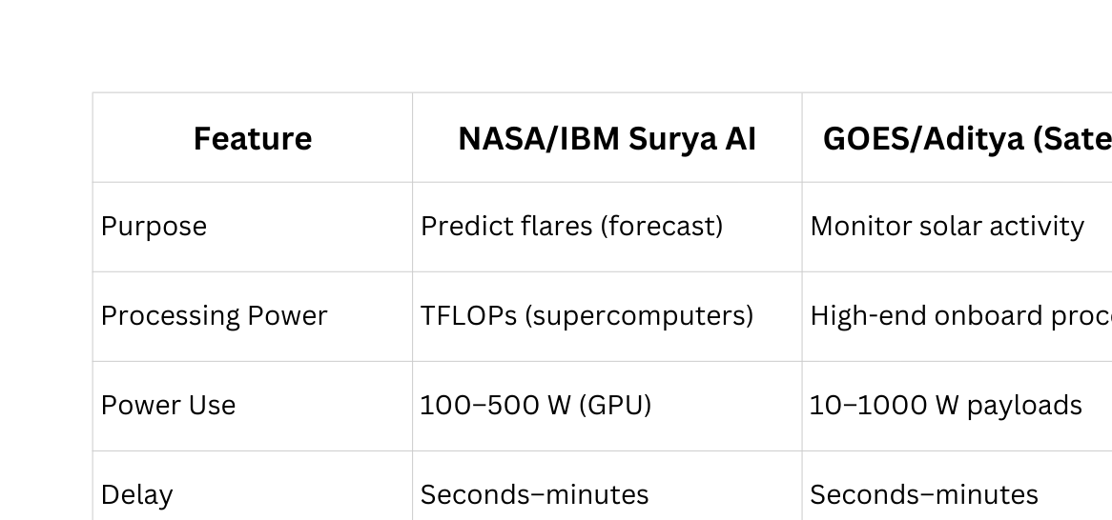
WHERE IT’S BETTER

Slide 12
SCOPE
In one month, we will refine our prototype by the following factors :
Practical and presentable.
UV photodiodes
Test the system under different light sources
Optimize the FPGA logic
More compact
Document the results
Prepare a clear demo

Slide 13


TEAM CONTRIBUTIONS
Sphoorti – Idea initiation & Software installation
Mounika – Research and Presentation design
Vyshamya – Research and Testing
All of Us – Hardware building

Slide 14

THANK YOU

